Slide 1
2 Kings 7:3-9 (NIV)
3 Now there were four men with leprosy at the entrance of the city gate. They said to each other, “Why stay here until we die?
4 If we say, ‘We’ll go into the city’—the famine is there, and we will die. And if we stay here, we will die. So let’s go over to the camp of the Arameans and surrender. If they spare us, we live; if they kill us, then we die.”
5 At dusk they got up and went to the camp of the Arameans. When they reached the edge of the camp, no one was there,
6 for the Lord had caused the Arameans to hear the sound of chariots and horses and a great army, so that they said to one another, “Look, the king of Israel has hired the Hittite and Egyptian kings to attack us!”

Slide 2
7 So they got up and fled in the dusk and abandoned their tents and their horses and donkeys. They left the camp as it was and ran for their lives.
8 The men who had leprosy reached the edge of the camp, entered one of the tents and ate and drank. Then they took silver, gold and clothes, and went off and hid them. They returned and entered another tent and took some things from it and hid them also.
9 Then they said to each other, “What we’re doing is not right. This is a day of good news and we are keeping it to ourselves. If we wait until daylight, punishment will overtake us. Let’s go at once and report this to the royal palace.”

Slide 3
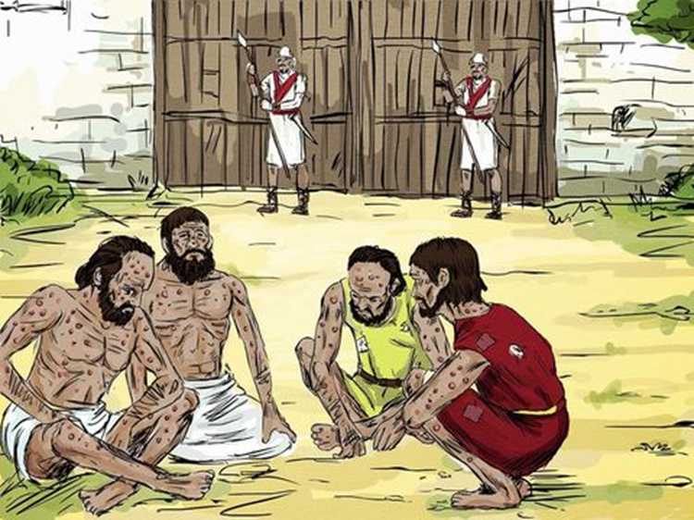
WHY SIT HERE AND DIE?

Slide 4
Deuteronomy 28:53
53 Because of the suffering your enemy will inflict on you during the siege, you will eat the fruit of the womb, the flesh of the sons and daughters the LORD your God has given you.

Slide 5
V. 1
Then Elisha said, “Listen to the word of the LORD; thus says the LORD, ‘Tomorrow about this time a measure of fine flour will be sold for a shekel, and two measures of barley for a shekel, in the gate of Samaria.'”

Slide 6
2 Hari 7:1
Mitubag si Eliseo, “Pamatia kining giingon sa GINOO: ‘Sa ingon niining orasa ugma, mahimong barato ang mga palaliton sa merkado sa Samaria. Ang tulo ka gantang nga harina ibaligya na lang sa kantidad nga usa ka buok nga pilak, ug ang unom ka gantang nga barley ibaligya usab sa kantidad nga usa ka buok nga pilak.’ ”

Slide 7
V. 2
The royal officer on whose hand the king was leaning answered the man of God and said, “Behold, if the LORD should make windows in heaven, could this thing be?” Then he said, “Behold, you will see it with your own eyes, but you will not eat of it.”

Slide 8
THE DESPERATION (vv.3-4)
3 Now there were four men with leprosy at the entrance of the city gate. They said to each other, “Why stay here until we die?
4 If we say, ‘We’ll go into the city’—the famine is there, and we will die. And if we stay here, we will die. So let’s go over to the camp of the Arameans and surrender. If they spare us, we live; if they kill us, then we die.”

Slide 9
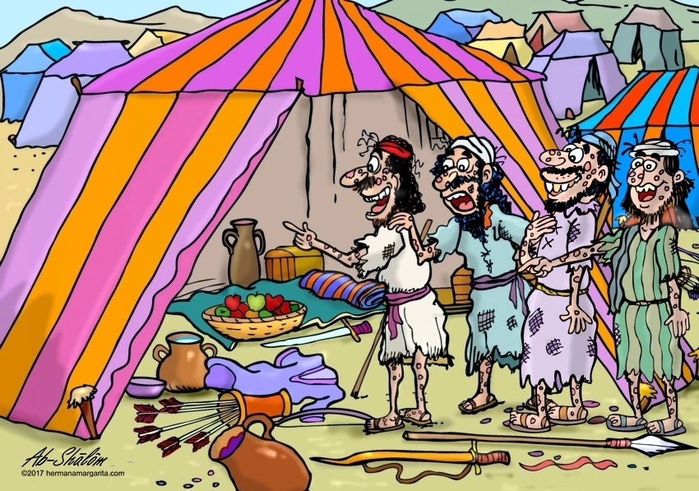
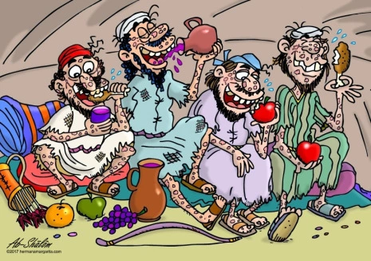
2. THE DISCOVERY (vv.5-8)
5 At dusk they got up and went to the camp of the Arameans. When they reached the edge of the camp, no one was there,
6 for the Lord had caused the Arameans to hear the sound of chariots and horses and a great army, so that they said to one another, “Look, the king of Israel has hired the Hittite and Egyptian kings to attack us!”
7 So they got up and fled in the dusk and abandoned their tents and their horses and donkeys. They left the camp as it was and ran for their lives.
8 The men who had leprosy reached the edge of the camp, entered one of the tents and ate and drank. Then they took silver, gold and clothes, and went off and hid them. They returned and entered another tent and took some things from it and hid them also.

Slide 10
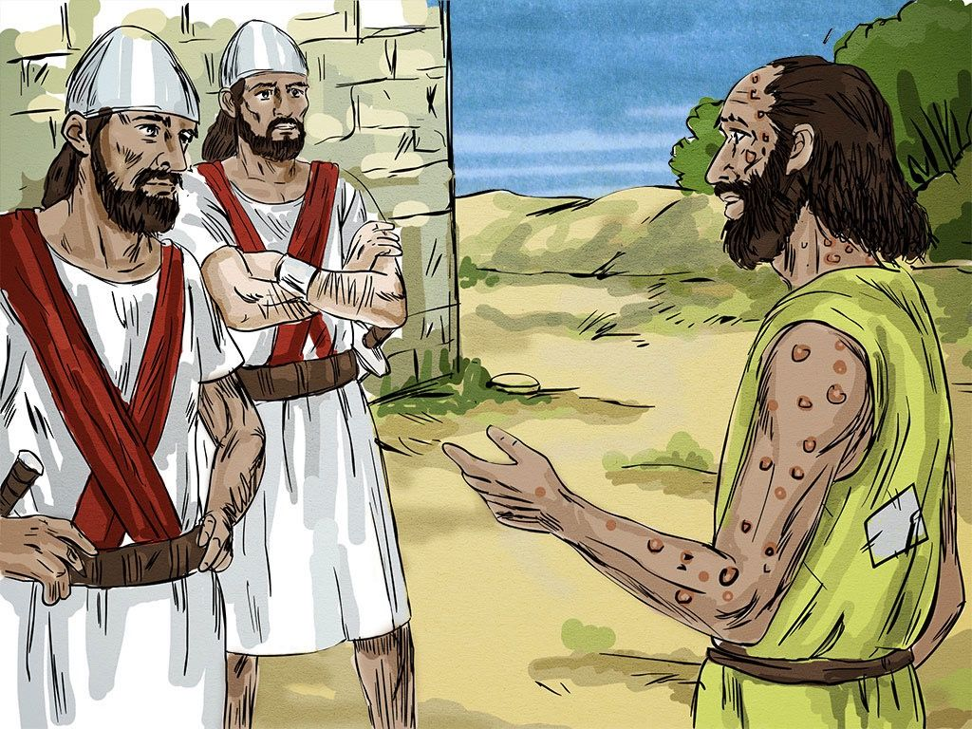
3. THE DUTY (v.9)
9 Then they said to each other, “What we’re doing is not right. This is a day of good news and we are keeping it to ourselves. If we wait until daylight, punishment will overtake us. Let’s go at once and report this to the royal palace.”

Slide 11
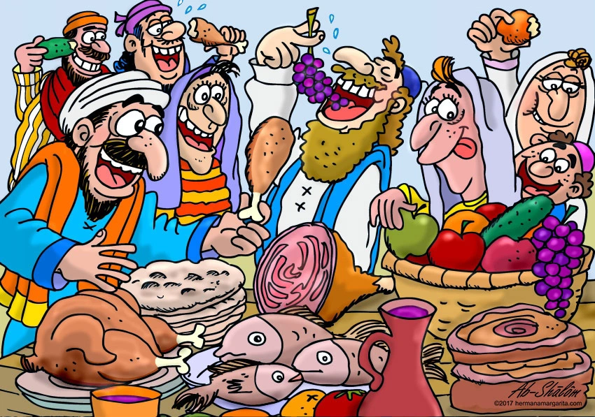
4. THE DELIVERANCE (v.16)
16 Then the people went out and plundered the camp of the Arameans. So a seah of the finest flour sold for a shekel, and two seahs of barley sold for a shekel, as the Lord had said.

Slide 13

